Slide 1
Descriptors: Detecting Interest Points, assigning Image Descriptors to them and Matching
D E P A R T M E N T O F C O M P U T E R S C I E N C E U N I V E R S I T Y O F C O P E N H A G E N
François Lauze
Notes:
Forelæsning: 32 (2013)
26 (2014)

Slide 2
Plan for today
More interest point detectors
Which type of interest point is best
Descriptor construction, the SIFT image descriptor
Matching: comparison of descriptors.

Slide 3
Recall: Linear scale space
The scale space of I is a 1-parameter family
Scale is given by σ and is an important parameter in CV algorithms
As the scale increases details in the image disappear and we focus on the large scale structures that are left.
Notes:
At scale sigma=0 we have the original image

Slide 4
Recall: Detecting blobs by Laplacian of Gaussian filter
Finding extrema in 2D:
Find points that are simultaneous extrema in the x and y direction.
We can solve this in one go by looking for extrema of the Laplacian of Gaussian filter
Bright blob: Dark blob:
Discrete implementation: Extrema search in 2D
Bright blob: than all neighbor pixels
Dark blob: than all neighbor pixels
4-neighbors or 8-neighbors
Keep only blobs where threshold value
Notes:
In principal we should look for points of zero gradient – these are all candidate points
The Laplacian (2nd order derivatives) tell us if it is a local maxima or minima.
By looking for local extrema of the Laplacian we are reducing further the amount of detected points.
Next year: Stress that the + in the Laplacian is pixelwise – matrix addition (they are not confident with matrices).

Slide 5
Interest point detectors: Multi-scale Laplacian blob detector
Finding extrema in scale-space:
Due to blurring, the Laplacian response decay over scale – solution: Use scale normalization.
Scale normalized Laplacian:
Bright blob: Dark blob:
Discrete implementation: Extrema search in 3D
Bright blob: than all neighbor pixels
Dark blob: than all neighbor pixels
6-neighbors or 26-neighbors
Keep only blobs where threshold value
Notes:
The max. response of Gaussian derivative filters decay with scale because of blurring / averaging. We can compensate for this by scale normalization.
Blurring lowers the contrast of the image (squeezing), by multiplying by the scale level we increases the contrast appropriately (stretching).
Next year: Try to improve the arguments for scale normalization.

Slide 6
Interest point detectors: Detecting Laplacian blobs (fixed scale)
Notes:
Gray scale intensities to make it easier to see if a blob is bright or dark
Yellow: Dark blobs
Red: Bright blobs
Scale = 4

Slide 7
Interest point detectors: Detecting Laplacian blobs (multi-scale)
Notes:
Circle radius is equal to detection scale

Slide 8
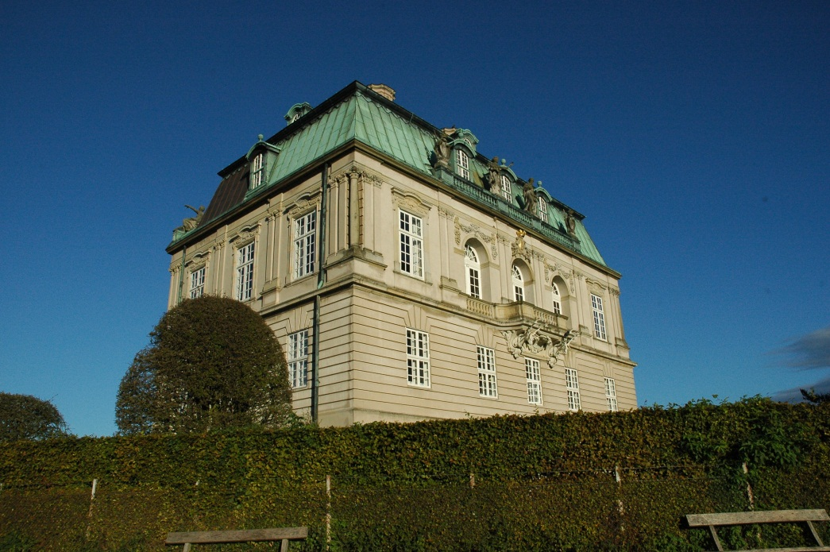
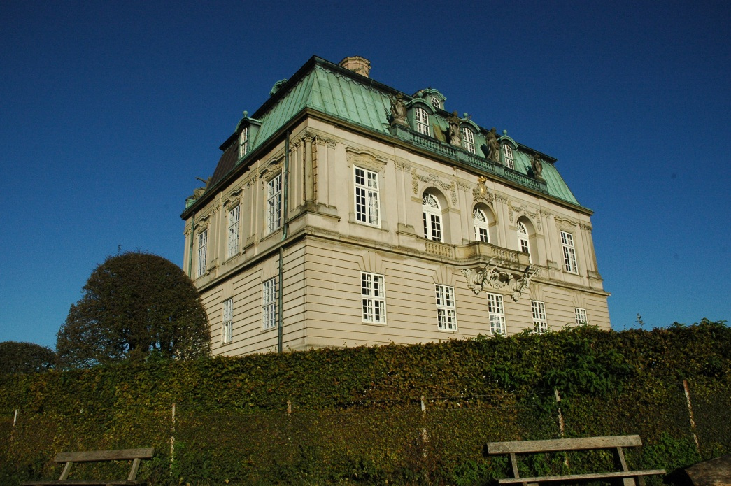
Fundamental Question: Where did the underlying feature go?
?
Notes:
Two different views of the same building

Slide 9
Regular grid vs random points vs salient points
Notes:
We are for now focusing on the approach of detecting salient points

Slide 10
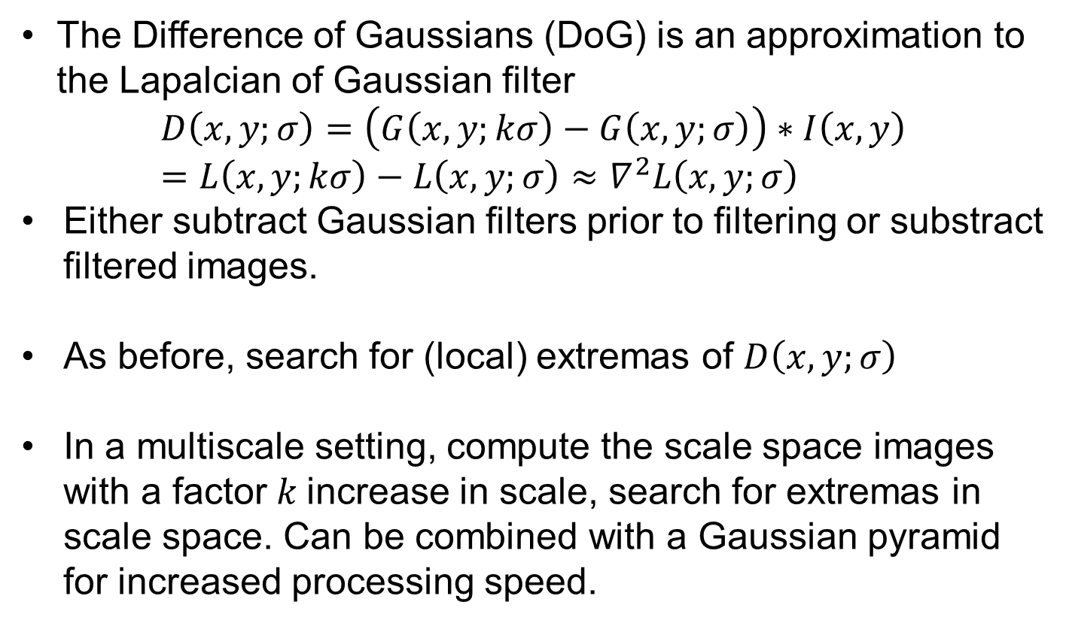
Interest point detectors: Detecting blobs by Difference of Gaussians (DoG)
The Difference of Gaussians (DoG) is an approximation to the Lapalcian of Gaussian filter
$$D\left(x,y;σ\right)=\left(G\left(x,y;kσ\right)−G\left(x,y;σ\right)\right)∗I\left(x,y\right)=L\left(x,y;kσ\right)−L\left(x,y;σ\right)≈∇^{2}L\left(x,y;σ\right)$$
Either subtract Gaussian filters prior to filtering or substract filtered images.
As before, search for (local) extremas of $D\left(x,y;σ\right)$
In a multiscale setting, compute the scale space images with a factor $k$increase in scale, search for extremas in scale space. Can be combined with a Gaussian pyramid for increased processing speed.

Slide 11
Interest point detectors: Detecting corners with Harris corner detector
Harris corners are defined as points of local maxima of the Harris corner measure:
Where
It encode gradient information under the window G.
R obtain maxima at intensity corners, but also for other structures.
This version is referred to as the improved or fixed scale Harris corner detector.
Notes:
Corners formed by iso-intensity curves. Look for regions of change in multiple directions.
Alpha is a constant that needs to be fixed, alpha=0.06
A is related to the autocorrelation function and is also sometimes referred to as the structure tensor.
Gaussian window. A matrix per pixel in the image
In terms of eigenvalues: R=e1*e2 – alpha * (e1 + e2)^2
The size of the response R tell us how much a corner this region resembles. Select only local maxima of R to get good corner candidates.
Next year: Give an intuitive explanation of why Harris detects corners.

Slide 12
Multi-scale versus multi-resolution: The Gaussian pyramid
Notes:
This is simply an implementation of scale space taking advantage of the reduction in detail
Next year: Consider adding a bit more details here: E.g. subsample by taking every second pixels after Gaussian blurring.

Slide 13
Interest point detectors: Detecting Harris corners (fixed scale)
Find max. of

Slide 14
Interest point detectors: Detecting Harris corners (multi-scale)
Find max. of
Notes:
Again search for maxima in scale-space (in 3D)

Slide 15
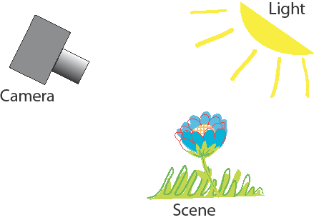
So, which detectors are the best?
We Want to Control it All in a Systematic Way
Kim S. Pedersen, Anders Dahl and Henrik Aanæs from DTU
Interesting Interest Points.
International Journal of Computer Vision, 97:18 – 35, 2012
Notes:
Light, scene and camera position and intrinsics are important factors.

Slide 16
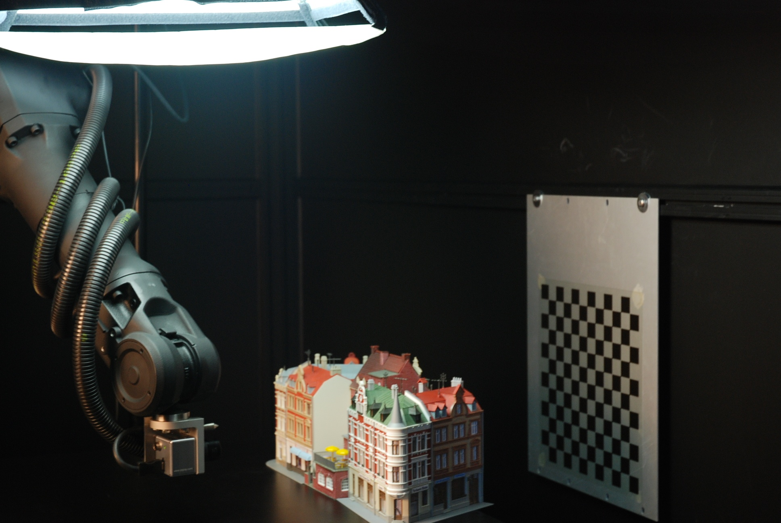
Method: Play Around with Robots ☺

Slide 17
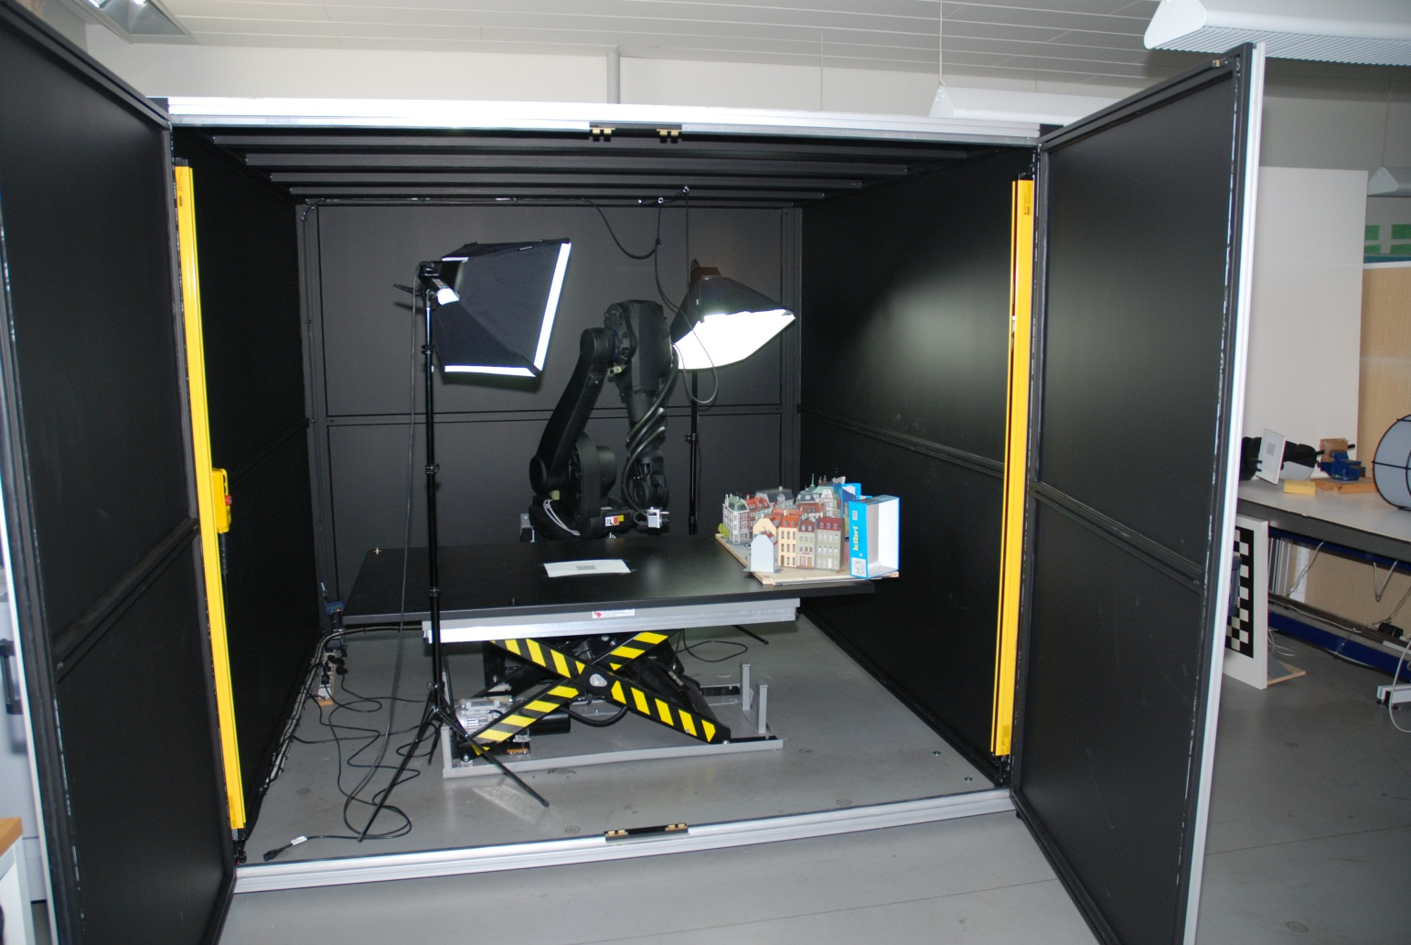
Method: A Configurable Computer Vision Workbench
Notes:
Actually the lamps are not used, instead an array of LED spot lights are used

Slide 18
Our Analysis: Investigate the recall rate of Interest Point Detectors
Detectors used:
Harris and Hessian Corner Detectors Mikolajczyk & Schmid 2004
Plain
Laplace
Affine
MSER Matas et al. 2004
Intensity & Edge Based Regions Tuytelaars & Van Gool 2009
Fast Corner detector Trajkovic & Hedley 1998
DoG Lowe 2004
Implementations downloaded of the net
Notes:
A potential match: If one or more points in the other image pass the 3 tests a match is counted for the point in the key frame.
Total Interest Points: Total number of interest points detected in the key frame.
Recall rate must be high

Slide 19
Evaluation Criteria: Determining the Correctness of a Match
Epipolar line
Epipolar plane
Baseline
Epipole
Notes:
Epipolar Geometry: Epipoles can be outside image plane.
Epipolar Line: A potential match in the other image must be within 2.5 pixels orthogonally on the epipolar line formed by the optical centers and the point in the key frame.
Surface geometry: The detected 3D points should lie close to the ground truth surface. Match consistent with the true geometry of the scene.
Absolute Scale: We want to see the same patch of 3D surface in both images, hence the detectors should localize interest point across scale

Slide 20
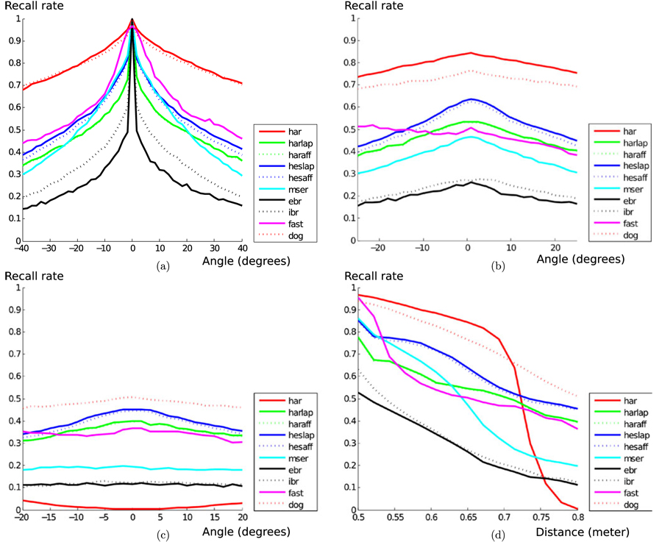
Effect of position
Notes:
Results averaged over all 60 scenes.
DoG and fixed scale Harris does well, except fixed scale Harris performs poorly over scale.
Multi-scale Harris actually perform quite well (/not included).

Slide 21
Outline of First Stage Findings
Light is more disruptive than position (angle & scale).
Best Performers are:
Harris Variants
DoG (SIFT Blobs)
MSER
Hessian Laplace Variants
Observations:
DoG (SIFT Blobs) is much better than Hessian Laplace.
Plain Harris is better than extensions, when scale does not change.
FAST is very erratic wrt. to number of features.

Slide 22
Matching Strategy Illustrated
1. Extract interest points; Harris corners, DoG (blobs)
2. Compute feature descriptors: raw patches, SIFT,…
3. Match by pairing similar descriptors
Notes:
Find potential matches – in principal we can have several candidates

Slide 23
What do we wish of a descriptor?
We have to attribute a descriptor to each feature point so as to compare whether a candidate match is good or not.
Descriptors have to be local, informative, insensitive to noise, luminance variations, perspective deformations, including rotation, to pixel quantization, etc.
We would be happy to use compact (low dimensional) descriptors, but must acknowledge this might be difficult.

Slide 24
Matching patches
?
Notes:
Is patch F1 similar to patch F2?

Slide 25
Using raw pixel patches as descriptors
Represent a patch with the raw pixels – the patch is the descriptor.
Compare patches pixel by pixel, e.g. by (For simplicity lets assume gray scale intensities and the sums are over all pixels in the patches.) (Patches must be of equal size)
This is referred to as either distances or dissimilarity measures
Notes:
Not similarity measures because we want them to have small values for similar patches and large values for dissimilar patches.

Slide 26
Using raw pixel patches as descriptors
We need to compensate for changes in illumination conditions, because …
Contrast change a and change in brightness level c (affine model):
We want F’ and F to have zero distance, but
Invariance wrt. affine intensity changes by normalization:
Notes:
The affine model of intensity distortions is not a completely realistic model, but is a good approximation.
Normalization: So how do we pick a and c?

Slide 27
Matching patches: Normalized cross correlation
Compute mean intensity and standard deviation for each patch (sum over all n pixels in patches)
Measure distance with normalized cross correlation
Affine intensity invariance:
Notes:
Subtract mean to remove additive constant and divide by variance to remove muliplicative contrast change factor. Standard deviation is a good measure of the constrast in a patch – It measures the spread of intensities in the patch.
Can also be interpreted as the angle (dot product) between the two patch vectors.

Slide 28
Matching patches
?
Notes:
Is patch F1 similar to patch F2?

Slide 29
Open problems
What patch size should we use?
Use the detection scale and resample so both patches have equal size in pixels
Is this approach robust to scale changes in the scene?
Yes, if we do the resampling (see above)
Is this approach robust to rotation and translation in the scene?
No, this will lead to large dissimilarities
Is it robust to perspective distortions?
No, this will lead to large dissimilarities

Slide 30
Scale Invariant Feature Transform (SIFT)
SIFT is a very popular descriptor (google.scholar says 49299 citations 3. Dec. 2018 (today…)).
Scale invariance:
This is obtained by using the DoG blob detector which is multi-scale. Descriptor build at these interest points in scale-space.
After detection we have an interest point at
Rotational invariance:
Estimate an orientation of the interest point and build the descriptor relative to this.
Translational invariance:
To some extend by construction of the descriptor (more on this)
Illumination invariance:
By construction of the descriptor (more on this)
Notes:
SIFT is popular and performs well, so lets go into details of what it does.
Several implementations available, but also patented.
16599 citations Nov. 2012

Slide 31
SIFT
Notes:
The idea is to …
This is the overview – lets go into details with each step.
Orientation assignment is not even on this chart

Slide 32
SIFT: Rotational invariance by orientation assignment
At detection scale compute image gradients
Gradient orientation and magnitude images
Build a 32 bin orientation histogram for neighborhood around
Every point weighted with m and a Gaussian window
for all points in the image
Notes:
In SIFT Lowe find the closest scale level in the Gaussian pyramid and compute gradients using pixel differences.

Slide 33
SIFT: Rotational invariance by orientation assignment
Find highest peak and its orientation
Create an interest point descriptor using this orientation
For all other peaks larger than 80% of the highest peak – also create a descriptor using these orientations
degrees
Notes:
High peaks mean that we have many gradients pointing in this direction and / or very large gradients. Example: There is an edge near the interest point so its orientations will dominate.
Highest peak is at 170 degrees
Only the peak at 200 degrees is above 80% of the 170 degree peak – height 10
Now rotate the coordinate system for the rest of the analysis, and maybe resample a rotated patch in the original image.

Slide 34
SIFT descriptor
Orientation image
Gradient images
8-bin histograms
Notes:
The paper suggest 16x16 pixel initial patches, but it can be larger.
8 bin orientation histograms (45 degrees bin width)
4x4 grid of histograms
Orientation image uses pseudo colors to show orientation angle.

Slide 35
The SIFT descriptor: Details
8-bin orientation histograms:
When adding to bin, every data point is weighted with m and a Gaussian aperture window
Adding a data point to a bin also add a little to the neighboring bins (linear interpolation)
Pixels on the other side of a histogram grid border contributes a little to the histogram (linear interpolation)
Feature vector:
Concatenate 8-bin histograms from the 4x4 grid into one vector with dimensionality 4x4x8 = 128.

Slide 36
The SIFT descriptor: Details
Normalization of feature vector:
Normalize the feature vector:
Non-linear illumination changes (e.g. shadows) may cause high gradient magnitudes locally.
Therefore reduce all bin values larger than 0.2 down to 0.2.
Renormalize (normalize again):
Notes:
First normalization removes the multiplicative constant from an affine light transformation.
Second reduces effects from cast shadows (only partially)

Slide 37
SIFT matching:
SIFT features are compared with Euclidean distance (L2-norm):
Matching SIFT features:
A match if this is true
Best refers to the distance for the pair of features with smallest distance.
2nd Best refers to the distance for the pair of features with second smallest distance.
Notes:
The sum runs over all the 128 dimensions of the SIFT feature.
Matching: The best match needs to be significantly better than other matches. Best distance <= Next_Best distance hence r <= 1.
This criterion is more stable than just using Best.

Slide 38
The SIFT descriptor invariance’s
Scale invariance:
From the (DoG) detector and further processing done at detection scale
Rotational invariance:
From the orientation assignment procedure
Approximate translational invariance:
From the detector and grid of histograms. Can handle translations up to 4 pixels (within a grid cell).
Affine illumination invariance:
From the choice of gradients additive brightness invariance is obtained. From normalization we obtain invariance to multiplicative contrast change.
Reduction of peaks gives some robustness to non-linear changes such as shadows.

Slide 39
Open problems for SIFT descriptors
Perspective distortion, but can be extended to obtain affine invariance
Non-linear illumination such as cast shadows, changes to light color, and material reflection properties
It is fairly high dimensional (128 dim.) and redundant
It is computationally intensive and relies on a careful implementation (= pretty hacky)

Slide 40
Variations on SIFT
There are many variations of the SIFT descriptor:
GLOH
SURF
DAISY
PCA SIFT
Opponent SIFT
Gaussian opponent SIFT
CSIFT
ORB
BRISK
FREAK
…
Notes:
And many more with even more exotic names

Slide 41
DAISY – a common SIFT variation: Locations and spread of histograms
Notes:
Notice that DAISY is actually not using histograms but instead splits gradients to positive and negative parts.

Slide 42
What is the best detector and descriptor combination?
A lot of work has been done, but much remains to be done
Results are not conclusive
Example from work by Kim S. Petersen, Anders Dahl and Henrik Aanæs using the DTU robot dataset.

Slide 43
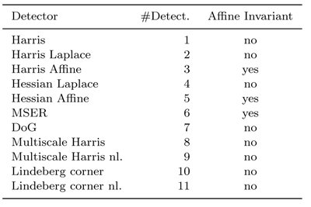
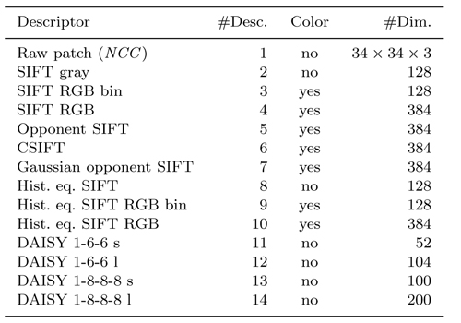
Detector - Descriptor Combination
Notes:
We look at all combinations of detector-descriptor from these tables (A matrix study)
Some descriptors work on color images.
Notice also the large variations in descriptor dimensionality

Slide 44
Evaluation Criteria
Extract features from the Key frame and another frame.
Matching criterion: Same as before except no scale
Compute: r = Best / 2nd Best < T
Compute ROC and AUC.
Use AUC as performance measure (average over scenes).
Notes:
Threshold T on distance ratio r and throw away all points larger than the threshold. Best <= Next_Best hence r <= 1
In ROC we change r to produce the curve.
In assignment 1, what I suggest you try is r < 0.8 and other threshold values.

Slide 45
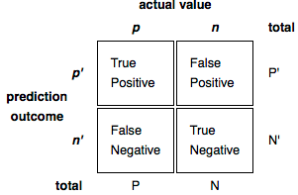
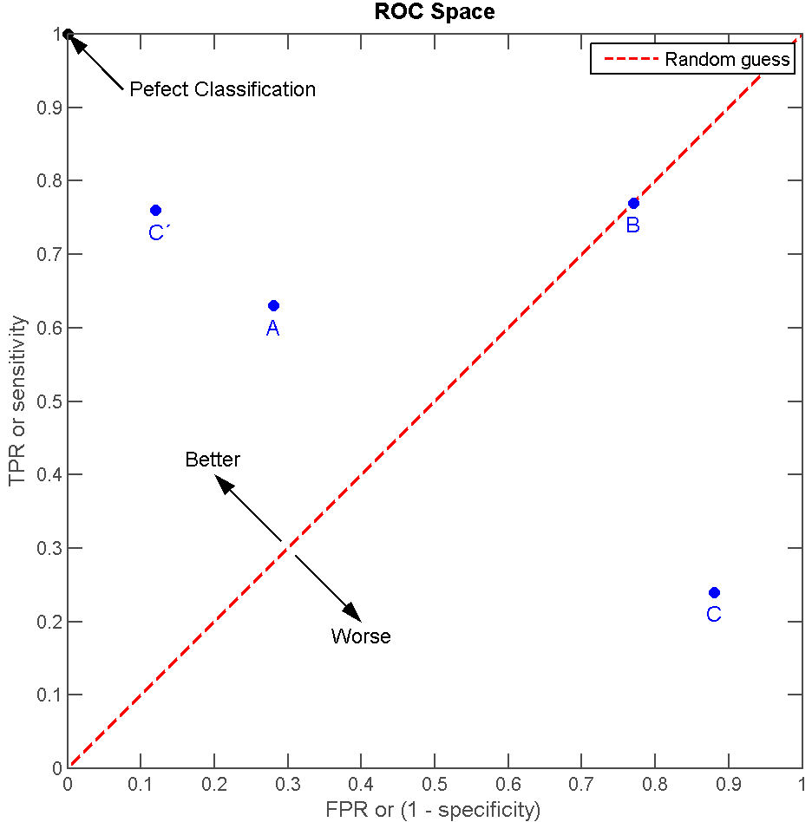
Aparté: Receiver Operating Characteristic (ROC) and Area Under the Curve (AUC)
Receiver operating characteristic (ROC):
TPR = TP / P
FPR = FP/N
Area Under the ROC Curve
Area close to 1 is good
The probability of a correct match

Slide 46
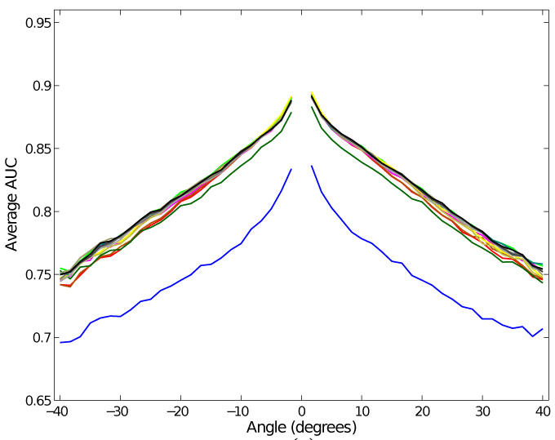
Results at a Glance, Descriptors
Notes:
Each curve represents a descriptor. The blue curve is Raw patch.
AUC averaged over scenes and interest point detectors.
The race is close – most (SIFT-like) descriptors have close to equal performance!

Slide 47
Outline of Findings
All SIFT based descriptors are almost created equal.
Multiscale Harris corner detector is the top performer.
With detectors the devil is in the details.
Light is very challenging.
On statistical significance…

Slide 48
Quote on Statistical Significance
“A question often overlooked by the computer vision community
when comparing results on a given dataset is whether the
difference in performance of two methods is
statistically significant.”
M. Everingham, L. Van Gool, C. K. I. Williams, J. Winn, A. Zisserman
“The PASCAL Visual Object Classes (VOC) Challenge”
International Journal of Computer Vision, Volume 88, Number 2,
page 303--338, 2010

Slide 49
Literature
Reading material
Lowe IJCV 2004 (Sec. 5 – 7.1)
Dahl, Aanæs, Pedersen 3DIMPVT 2011
Dahl, Aanæs, Pedersen IJCV 2012
Additional Material
Larsen et al. ECCV 2012
Lindeberg 1996 (Multiscale detection)
Lindeberg. Feature detection with automatic scale selection. IJCV 1998

Slide 50
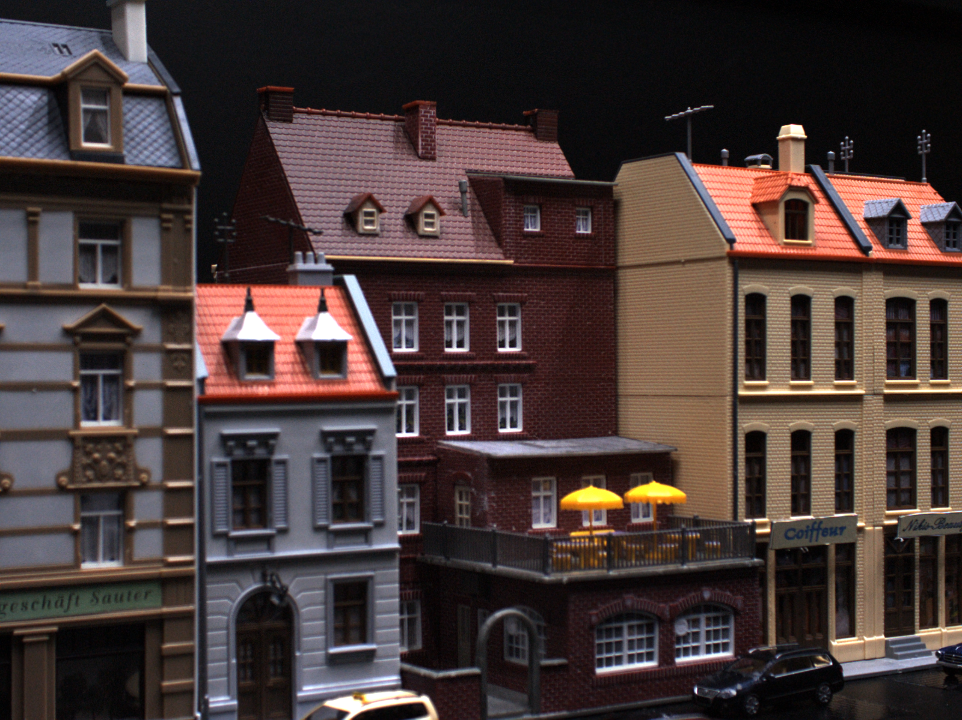
Mandatory assignment 2 deadline approaching!

